Slide 1
TAS 152
LECTURE 1
TOPIC 1
CYBER SOCIETY: CORE VALUES AND VIRTUES
1.1 THE NATURE OF CYBERSPACE

Slide 2
LECTURE CONTENTS
Topic 1 - Cyber society: Core values and virtues
Interacting in cyberspace
How does cyber space differ from the physical world?
Activity

Slide 3
TOPIC 1 – CYBER SOCIETY: CORE VALUES AND VIRTUES
Cyber society: Core values and virtues
Before we can talk about cyber society, we need to talk about cyberspace.
What is cyberspace?
An online environment within which Internet technologies are used to support interaction and communication between governments, organisations, communities, and individuals.
A global domain within the information environment consisting of the interdependent network of information technology infrastructures and resident data, including the Internet, telecommunications networks, computer systems, and embedded processors and controllers.

Slide 4
INTERACTING IN CYBERSPACE
How does cyber-space differ from the physical world?
Time
Space
Size
Virtual
Anonymous
Money
Power

Slide 5
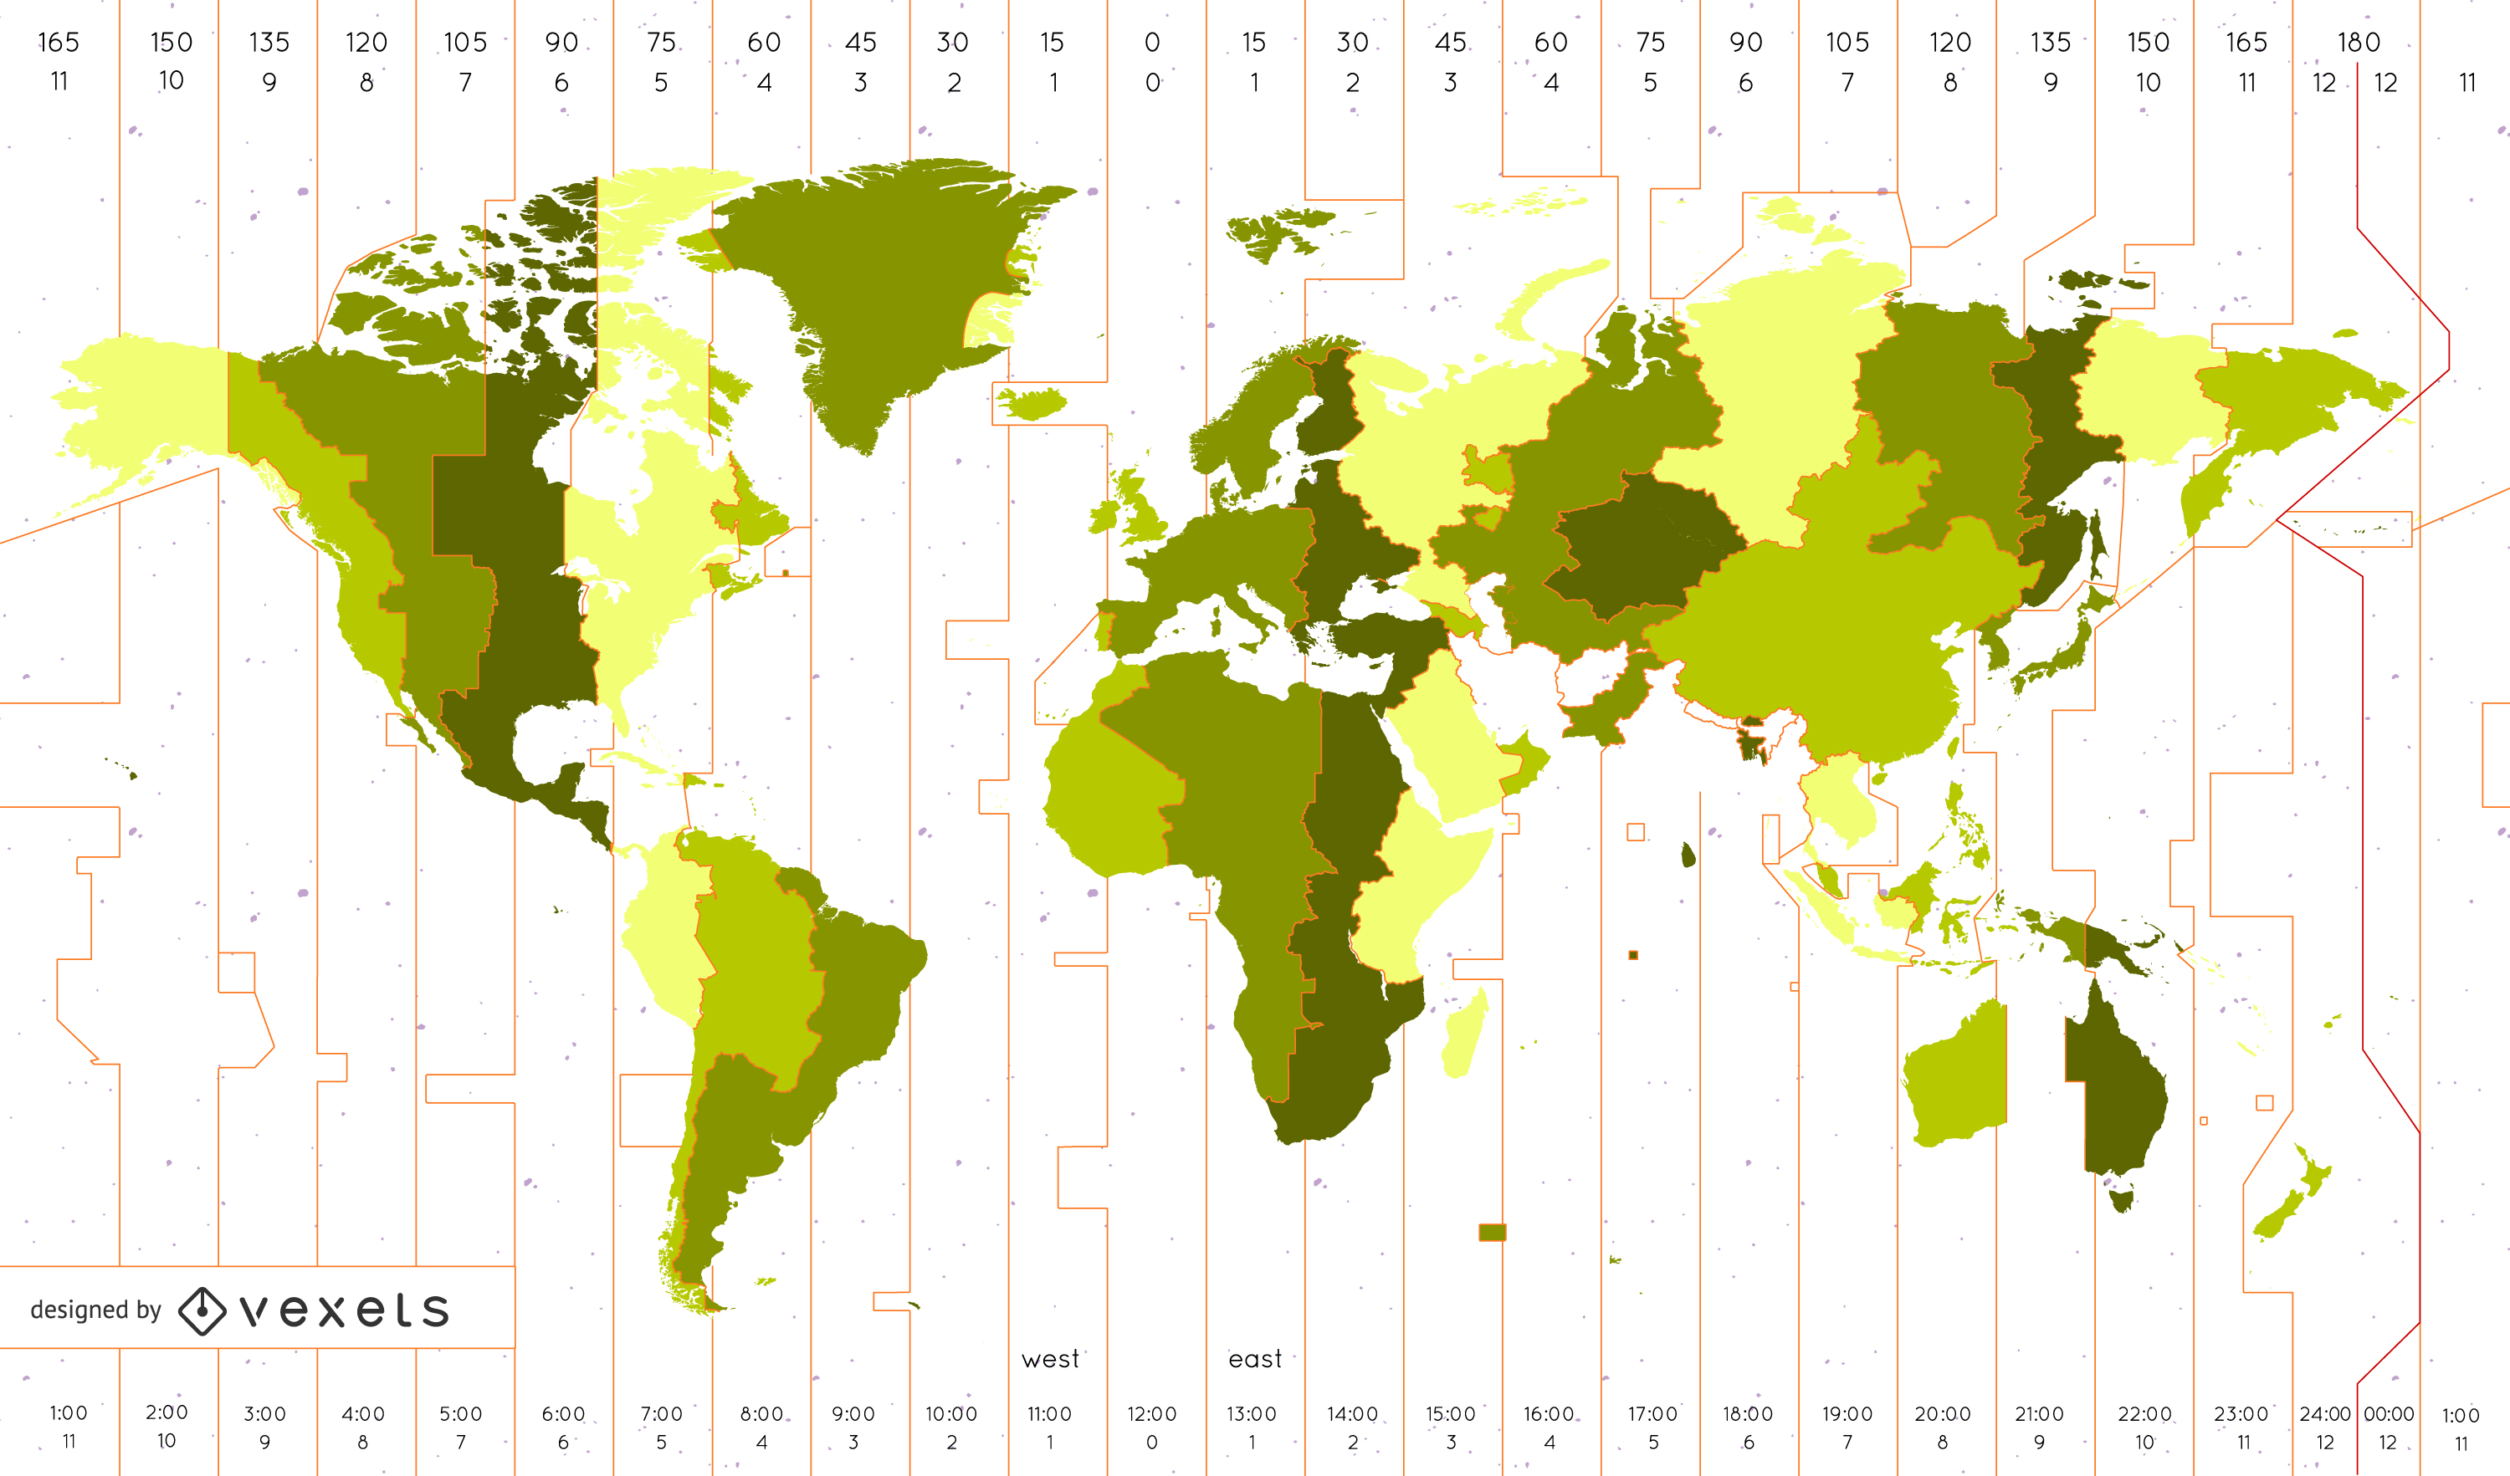
HOW DOES CYBERSPACE DIFFER?
time...
The physical time zone in which a human being is located.
In cyberspace information is accessible at any time of day, any day of the week.
This can be good
You can't go to a library at 2 am.
This can also be bad
Timezone differences

Slide 6
TIME
How many time zones are there? What are their offsets?
https://hackaday.com/2024/02/14/how-many-time-zones-are-there-anyway/
What are the pros and cons of working across different time zones?
https://www.turing.com/kb/pros-cons-of-working-across-time-zones

Slide 7
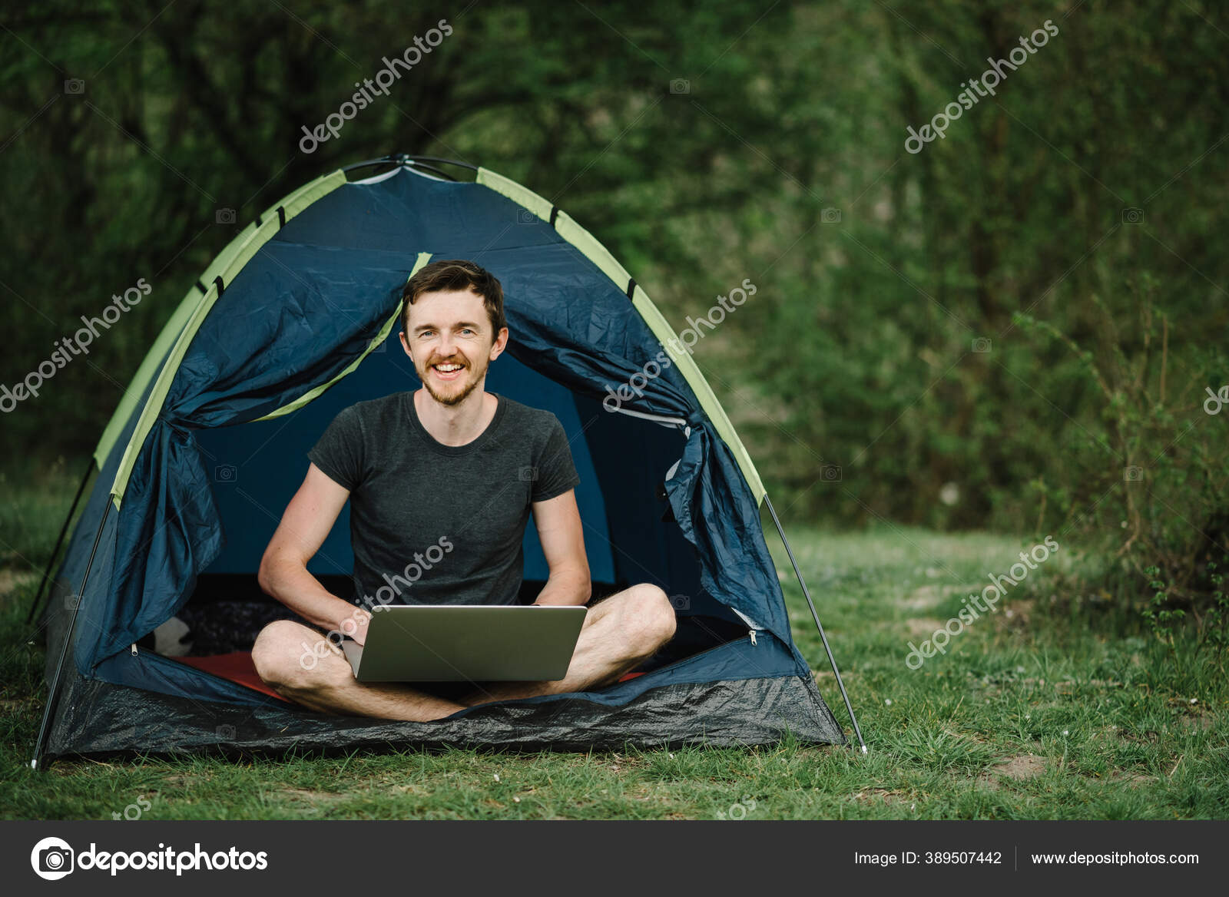
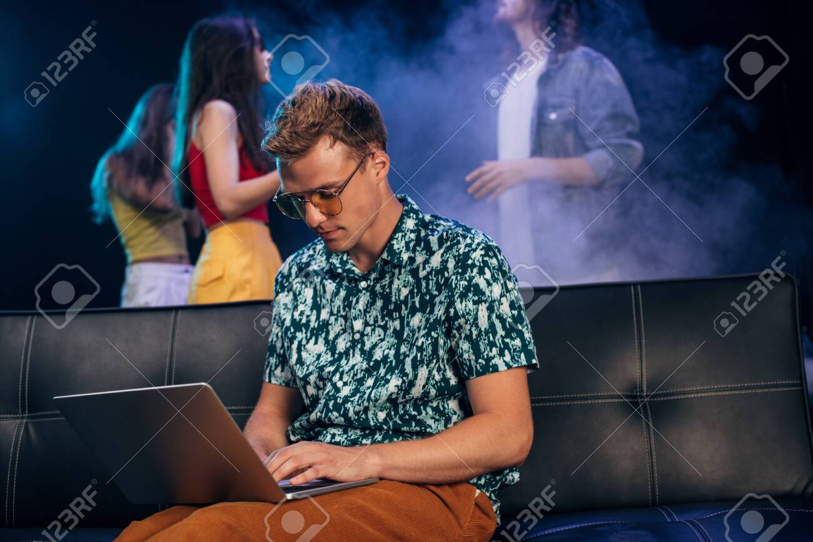
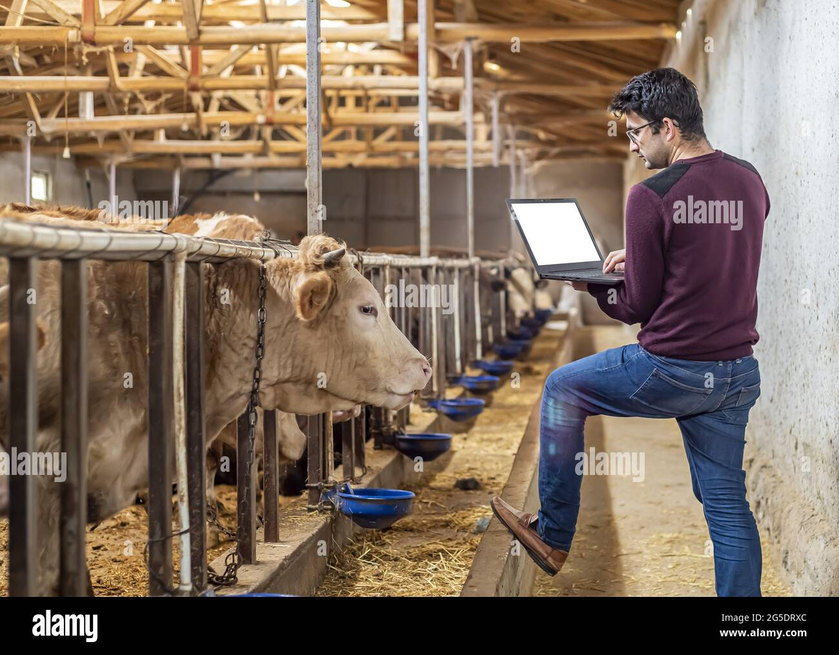

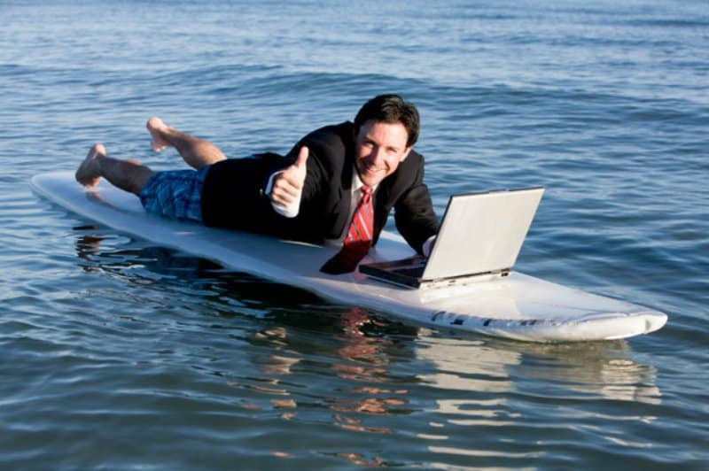
HOW DOES CYBERSPACE DIFFER?
space...
The physical location in which a human being is located.
Cyberspace is not bound to a physical location
This can be good
You don't need to travel to a specific physical location to enter cyberspace.
This can also be bad
Human beings are bound to specific physical locations.

Slide 8
SPACE
The physical space you are in governs how likely you are to use cyber space
https://www.researchgate.net/profile/Valerie-Goby/publication/8891279_Physical_Space_and_Cyberspace_How_Do_They_Interrelate_A_Study_of_Offline_and_Online_Social_Interaction_Choice_in_Singapore/links/57ec841708ae92a5dbd0753f/Physical-Space-and-Cyberspace-How-Do-They-Interrelate-A-Study-of-Offline-and-Online-Social-Interaction-Choice-in-Singapore.pdf
Legally, how do we differentiate between cyberspace and physical space and the laws that govern them?
https://legalvidhiya.com/cyberspace-vs-physical-space/
Threats in cyberspace can end up becoming threats in physical space as well.
https://www.controlrisks.com/our-thinking/insights/growing-convergence-of-physical-and-cyber-threats-on-the-african-continent-1

Slide 9
HOW DOES CYBERSPACE DIFFER?
size...
The quantity of information that is produced.
The number of human beings that consume information.
This can be good
There is a much higher likelihood of finding information online.
This can also be bad
The immense amounts of information available within the cyberspace can be overwhelming.

Slide 10
SIZE
What is information overload?
https://www.techtarget.com/whatis/definition/information-overload
(see also: doomscrolling)
How can we prevent information overload?
https://www.lifehack.org/922480/information-overload

Slide 11
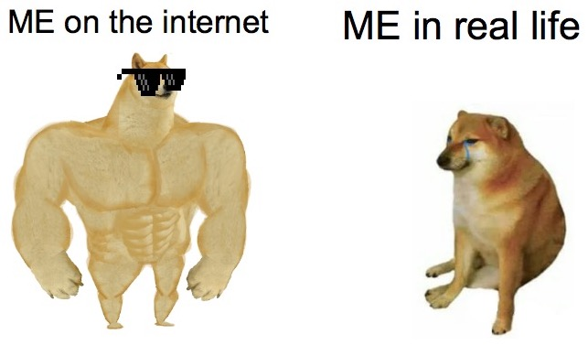
HOW DOES CYBERSPACE DIFFER?
virtual...
Cyberspace is a virtual world.
The physical world is material, cyberspace is digital.
This can be good
Equal participation for individuals with disabilities.
This can also be bad
The line between the virtual and physical world becoming blurred is dangerous.

Slide 12
VIRTUAL
Swatting:
https://time.com/6551369/swatting-hoax-mtg-maine-secretary-state/
Parasocial relationships:
https://glasgowguardian.co.uk/2024/01/05/parasocial-relationships-in-the-internet-era/

Slide 13
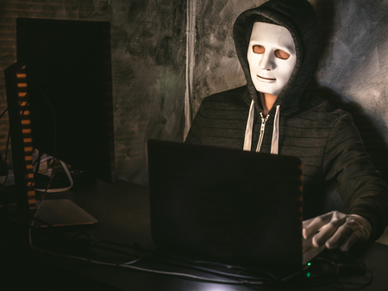
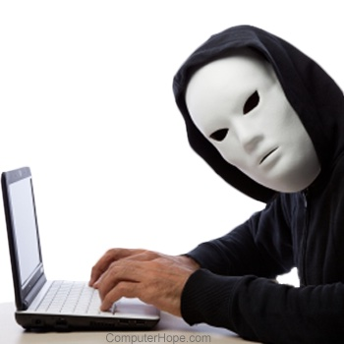
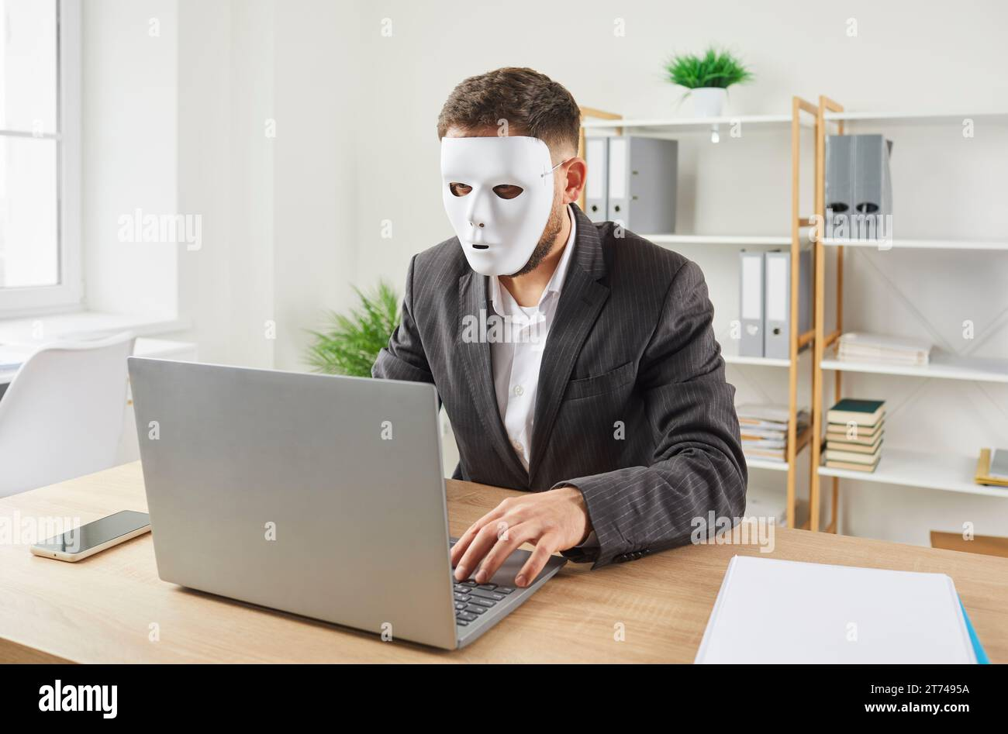

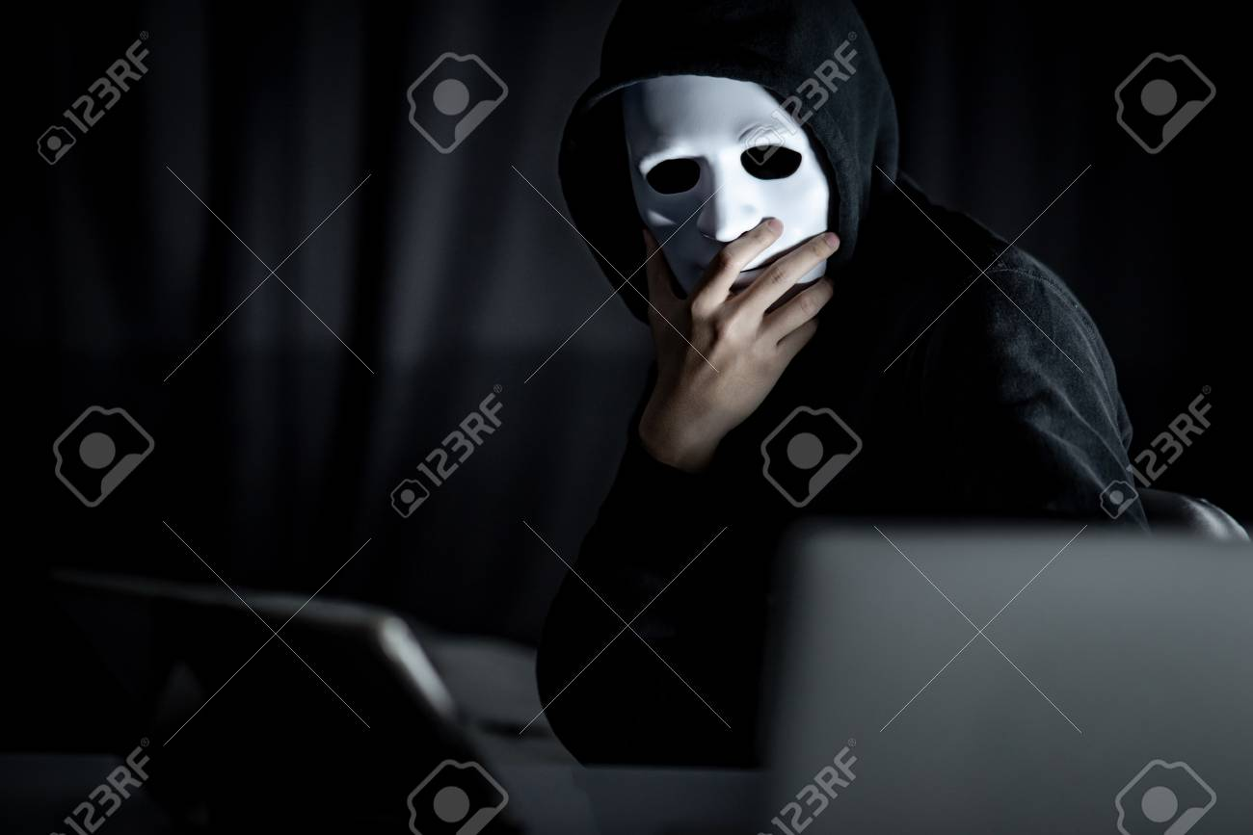
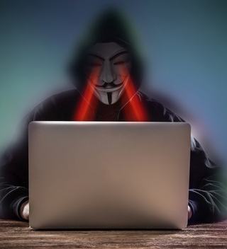
HOW DOES CYBERSPACE DIFFER?
anonymous...
Users can assume a different identity, multiple identities or remain entirely anonymous within cyberspace.
This can be good
Privacy, freedom and stops unwanted tracking.
This can also be bad
No way of knowing whether the identity of somebody is genuine.

Slide 14
ANONYMOUS
How can you be more "anonymous" online?
https://www.wired.co.uk/article/how-to-be-more-anonymous-online
Why do people want to be anonymous online?
https://www.techiexpert.com/reasons-why-people-seek-anonymity-on-the-internet/
Why is online anonymity so important?
https://digitalrightswatch.org.au/2021/04/30/explainer-anonymity-online-is-important/

Slide 15
HOW DOES CYBERSPACE DIFFER?
With regards to money...
The monetary cost associated with interacting in cyberspace.
This can be good
To a large extent, engaging with cyberspace is free.
This can also be bad
Access to cyberspace is however not cost free.

Slide 16
MONEY
How do mobile data prices in South Africa compare internationally?
https://mybroadband.co.za/news/cellular/509180-mobile-data-prices-in-south-africa-vs-236-countries.html
How do mobile data prices in South Africa compare to other African countries?
https://www.itweb.co.za/article/sas-1gb-data-prices-still-higher-than-african-counterparts/P3gQ2MGAXBRvnRD1
Should internet access be considered a modern human right?
https://www.dazeddigital.com/life-culture/article/59956/1/internet-access-basic-human-right-merten-reglitz-broadband-cost-of-living-uk
https://www.amnestyusa.org/updates/is-internet-access-a-human-right/

Slide 17
HOW DOES CYBERSPACE DIFFER?
With regards to power...
The power structures that are relevant and how they affect the participants.
This can be good
There are fewer restrictions placed on cyberspace users.
This can also be bad
Power structures may be implicit and hidden.

Slide 18
POWER
WeChat is an example of an online platform that has an implicit power structure behind it.
https://en.wikipedia.org/wiki/WeChat#:~:text=Weixin%2C%20the%20Chinese%20version%20of%20WeChat%2C%20operates%20from%20China%20under,Law%20and%20National%20Intelligence%20Law.
Many online communities allow power structures to evolve organically (i.e. Whatsapp group admins, Discord admins) however wherever there is power to be had, there are those who will try to abuse it.

Slide 19
ACTIVITY
Has your data already been breached? Check whether any of your passwords have been compromised at https://haveibeenpwned.com/.
Lesser known cyber risks
Pig-butchering
AI generated images
AI generated voices

